Slide 1
Master’s Defense
Kyle Coapman
June 10, 2020

Slide 2
Agenda
Introduction and Context
Student Academic Results
Student Character Results
Portfolio Entries
Key Insights

Slide 3

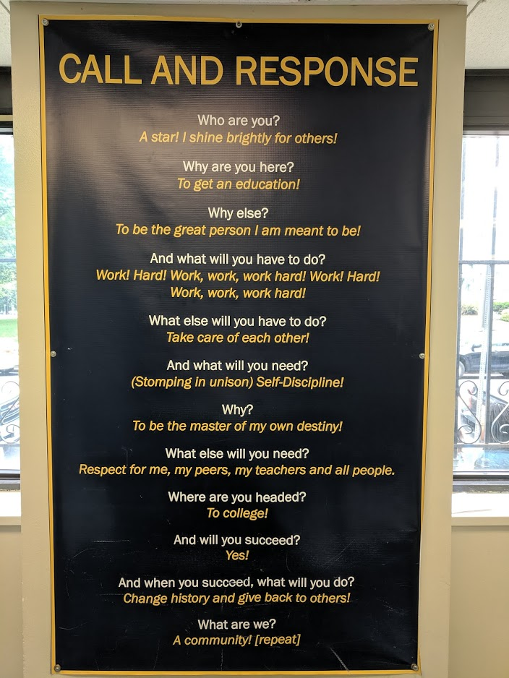
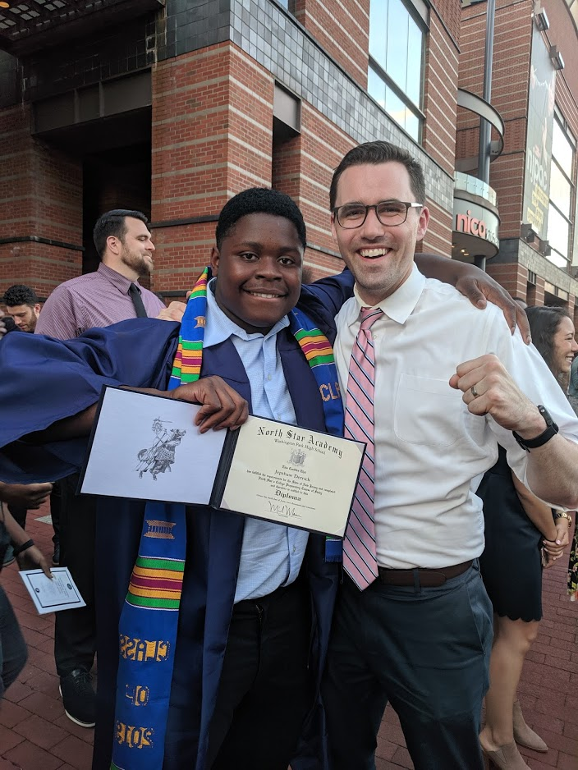
North Star Academy Washington Park HS

Slide 4

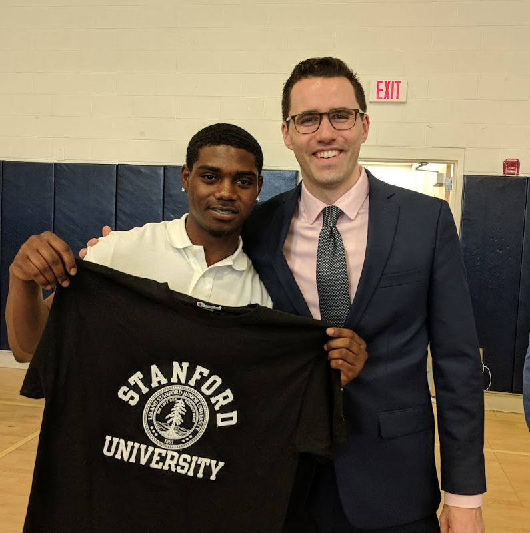

AP Calculus BC

Slide 5
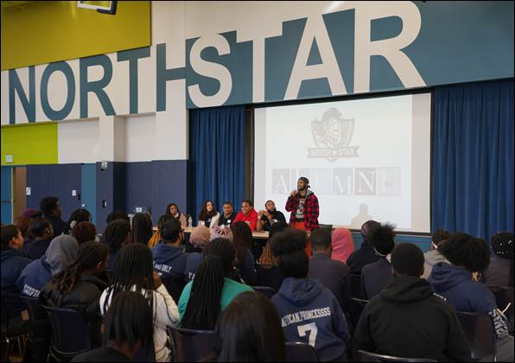
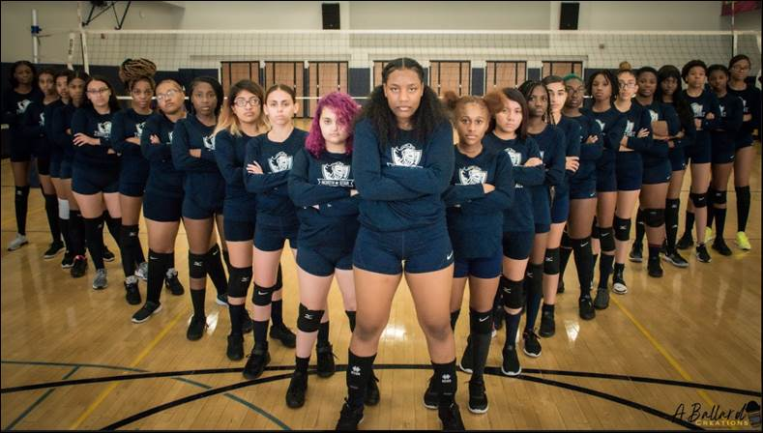
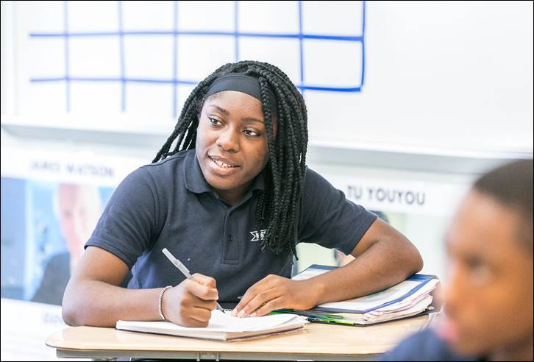
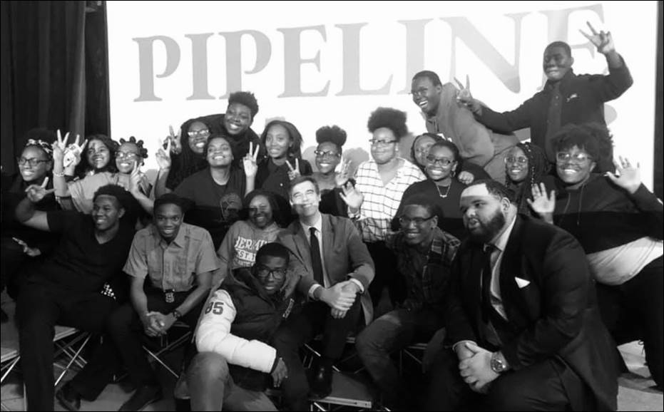
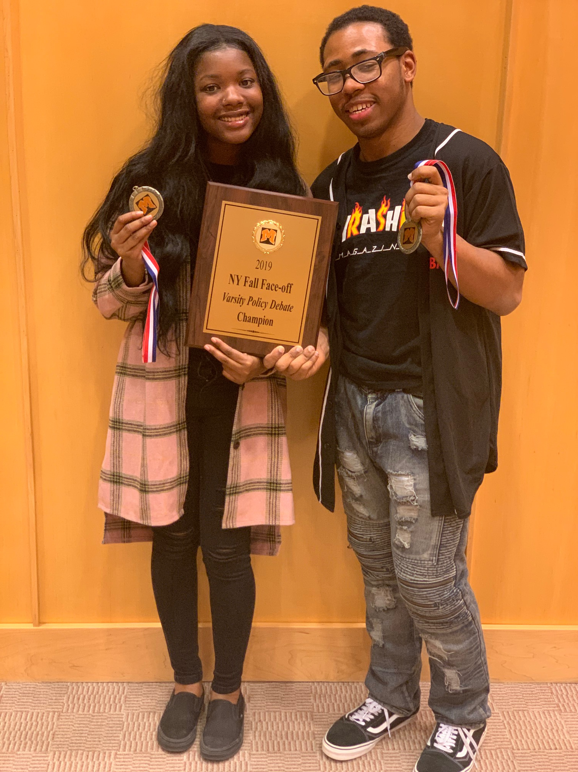
Students

Slide 6
Academic Goals
Proficient: On average, students will achieve an average standards mastery of 55% of the selected set of standards.
Ambitious: On average, students will achieve an average standards mastery of 65% of the selected set of standards.
Notes:
Give context for each of these goals >> pushing for the 4 and 5
*

Slide 7
Overall Standards Mastery (March 2020)
49.96%

Slide 8
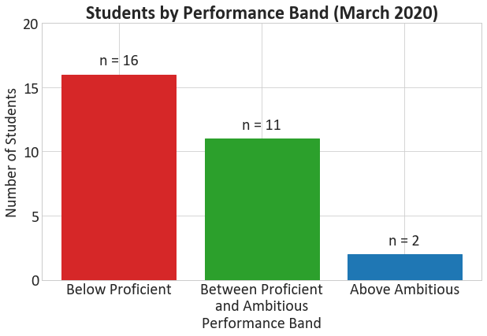
Overall Standards Mastery

Slide 9
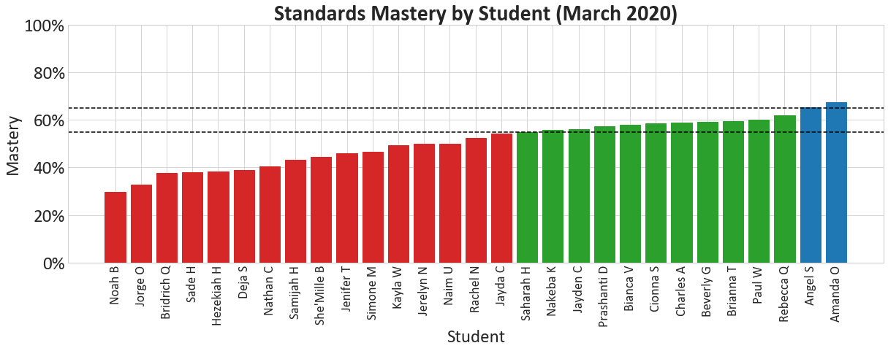
Mastery by Student

Slide 10
Research Question #1
What, if any were the achievement differences between students who took Pre-AP Calculus and those who took AP Calculus AB during their junior year?

Slide 11
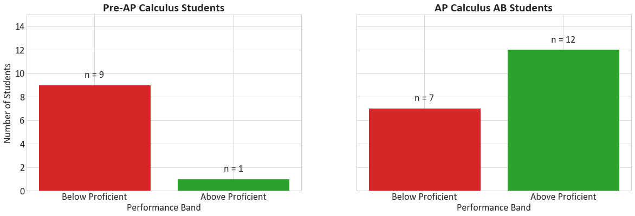
What, if any were the achievement differences between students who took Pre-AP Calculus and those who took AP Calculus AB during their junior year?
T-test for two independent sample, p-value = 0.00013

Slide 12
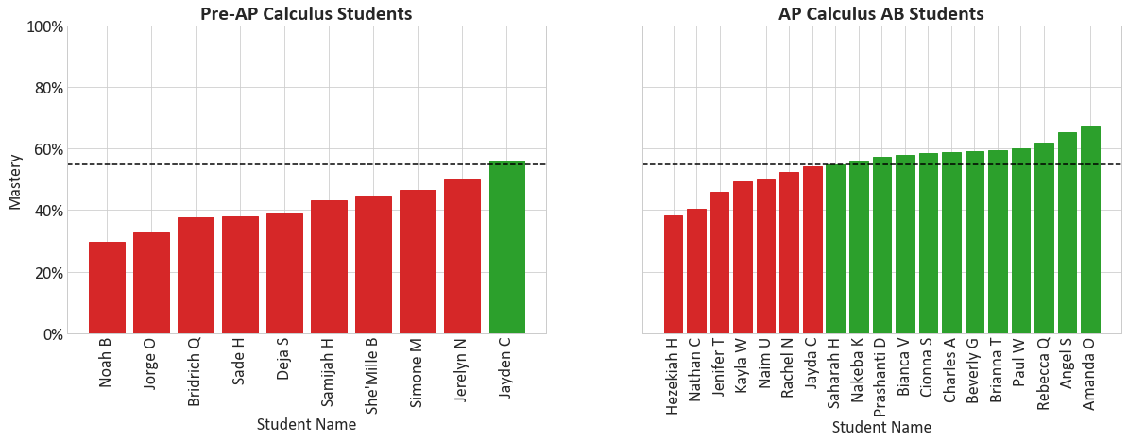
What, if any were the achievement differences between students who took Pre-AP Calculus and those who took AP Calculus AB during their junior year?

Slide 13
What, if any were the achievement differences between students who took Pre-AP Calculus and those who took AP Calculus AB during their junior year?
There is a statistically significant difference between these two subgroups (p = 0.00013)
AP Calculus AB students performed significantly higher (55% on average) than Pre-AP Calculus students (42% on average)
AP Calculus AB students had previously learned most of the new content this year. Pre-AP Calculus students were learning content for the first time.
Notes:
FORMALIZE THIS IN DATA NARRATIVE → then update this slide

Slide 14
Implications for Teachers and Leaders
Option #1: Use homogeneous sections to calibrate teaching to each group.
Option #2: Continue with heterogenous sections, but need to leverage differentiation, intentional seating, and reciprocal teaching strategies.

Slide 15
Research Question #2
What, if any, achievement differences exist between students that scored at or above mastery in character development vs. students that scored below mastery?

Slide 16
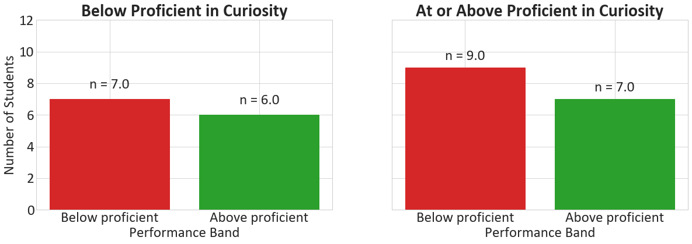
What, if any, achievement differences exist between students that scored at or above mastery in character development vs. students that scored below mastery?
T-test for two independent sample, p-value = 0.960644

Slide 17
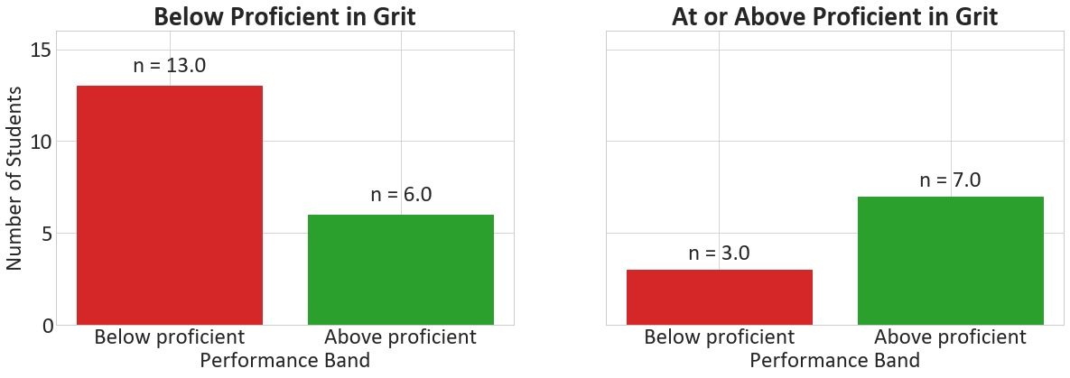
What, if any, achievement differences exist between students that scored at or above mastery in character development vs. students that scored below mastery?
T-test for two independent sample, p-value = 0.05177

Slide 18
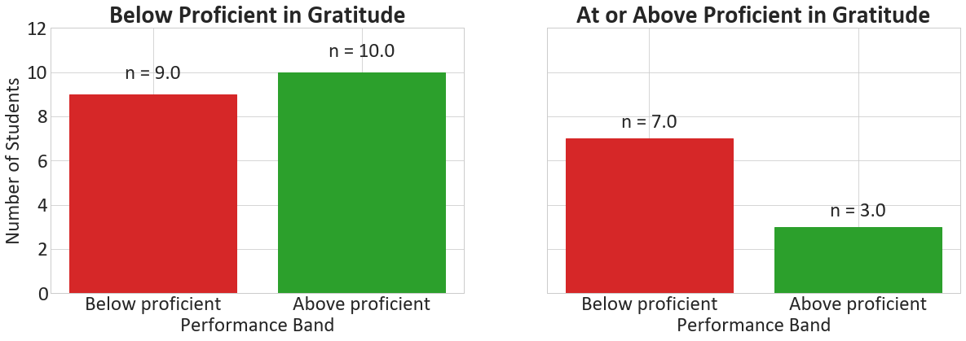
What, if any, achievement differences exist between students that scored at or above mastery in character development vs. students that scored below mastery?
T-test for two independent sample, p-value = 0.41587

Slide 19
What, if any, achievement differences exist between students that scored at or above mastery in character development vs. students that scored below mastery?
Curiosity and Gratitude proficiency did not reveal significant achievement differences.
Grit proficiency demonstrated the strongest impact on student's achievement, thought not statistically significant.
AP Calculus BC is an extremely challenging course; grit is an important character strength for overcoming the obstacles that students will inevitably face.

Slide 20
Implications for Teachers and Leaders
Curiosity and Gratitude are still essential character strengths for developing students interpersonal and social skills.
Grit showed the strongest connection to improving academic achievement.
Teachers and leaders should continue to develop all character strengths; however, grit is of particular importance in succeeding in challenging coursework in high school and college.

Slide 21
My Perspective on Academic Results
The AP Calculus curriculum requires that we move through the content very quickly.
Students appear to struggle synthesizing all the understandings on assessments.
AP Calculus AB students are excelling and could be pushed further.
Pre-AP Calculus students need more support from peers and myself.
Notes:
FORMALIZE THIS IN DATA NARRATIVE → then update this slide

Slide 22
My Perspective on Academic Results
In the future, I will leverage floating block and small group tutorials to work with the Pre-AP Calculus course earlier in the year. They need more support.
For AP Calculus AB students, I will leverage this group to lead review for Pre-AP Calculus students. I will also provide enrichment opportunities to develop deeper understandings of the content.
Notes:
FORMALIZE THIS IN DATA NARRATIVE → then update this slide

Slide 23
Character Goal
Proficient: On average, students will score a 4 on curiosity indicators by the end of to course as scored by students, the teacher, and corresponding English teachers.
Notes:
Give context for each of these goals >> pushing for the 4 and 5
*
https://pixabay.com/illustrations/question-mark-important-sign-1872665/

Slide 24
Character Goal (March 2020)
3.83
Notes:
Give context for each of these goals >> pushing for the 4 and 5
*
https://pixabay.com/illustrations/question-mark-important-sign-1872665/

Slide 25
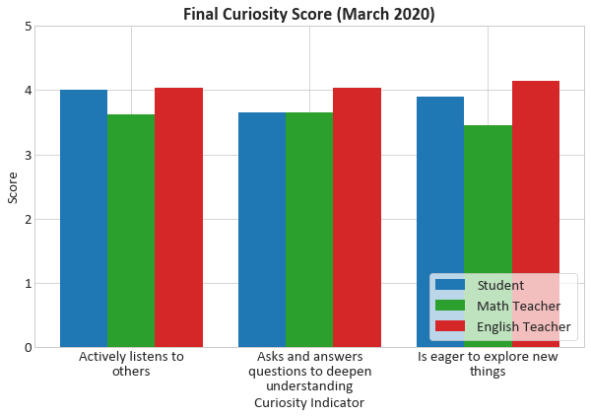
Character Results - Mastery

Slide 26
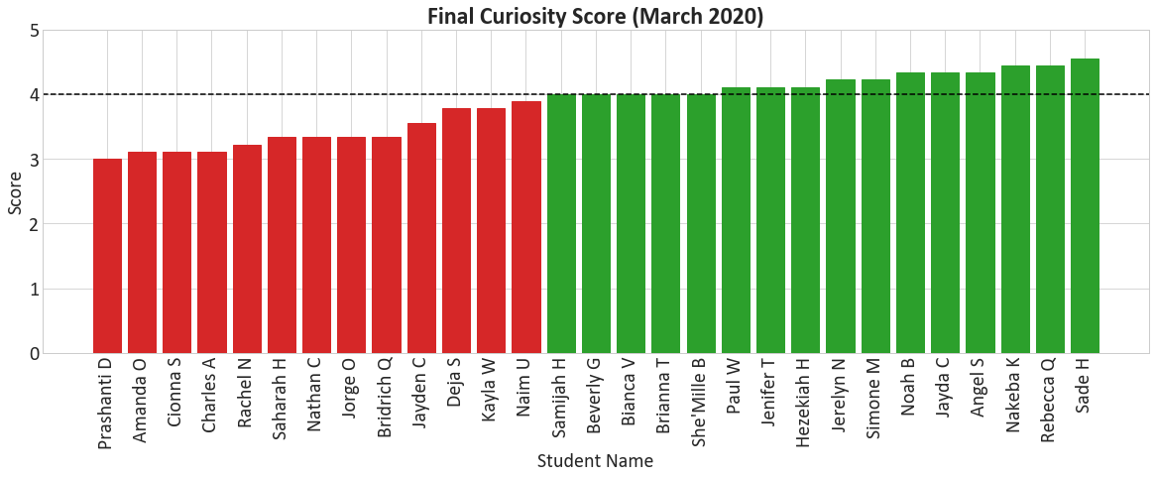
Character Results - Mastery

Slide 27
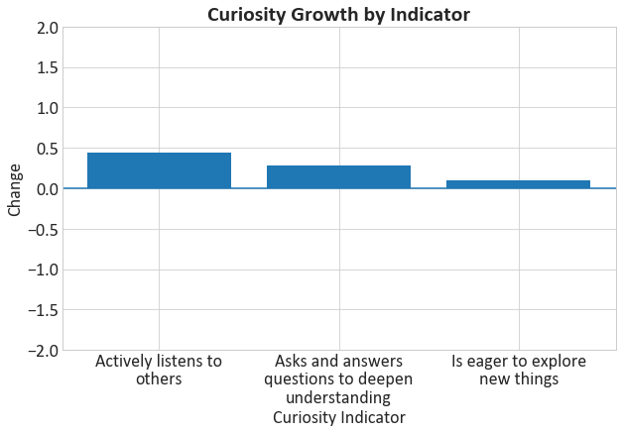
Character Results - Growth
Notes:
Why do I think that these few students dipped in curiosity (why do you think that these dipped)

Slide 28
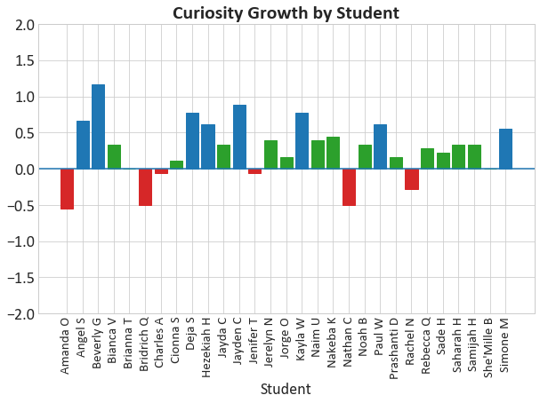
Character Results - Growth
Notes:
Why do I think that these few students dipped in curiosity (why do you think that these dipped)

Slide 29
My Perspective on Character Results
I am impressed with the +0.5 growth from eight students.
I would have appreciated more time to work with the six students who showed a decline in their curiosity.
Notes:
Keep the actions here for curiosity.
FORMALIZE THIS IN DATA NARRATIVE → then update this slide

Slide 30
My Perspective on Character Results
In future development of curiosity:
Curiosity shout outs after a review session.
Curiosity wall of What If questions that accumulate throughout each unit.
Notes:
Keep the actions here for curiosity.
FORMALIZE THIS IN DATA NARRATIVE → then update this slide

Slide 31
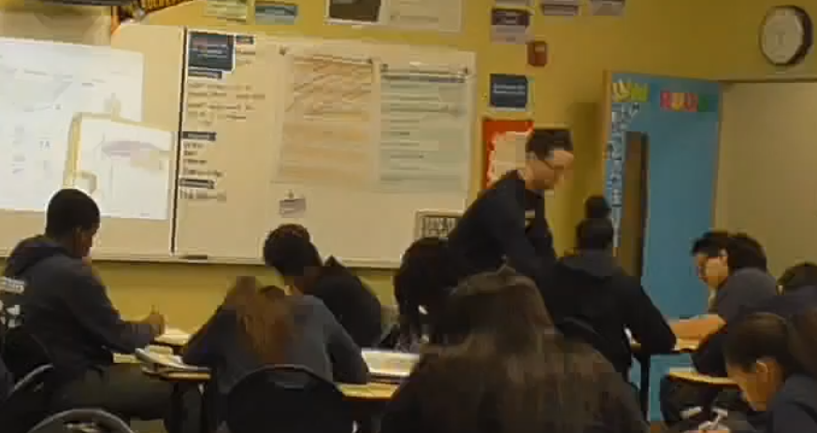
Portfolio Entry #1
Self and Other People (SOP)
Student Relationships
Surveys
Check ins / One on Ones
Shout Outs
Goal Setting
Notes:
UPDATE PORTFOLIO >> then update this slide

Slide 32
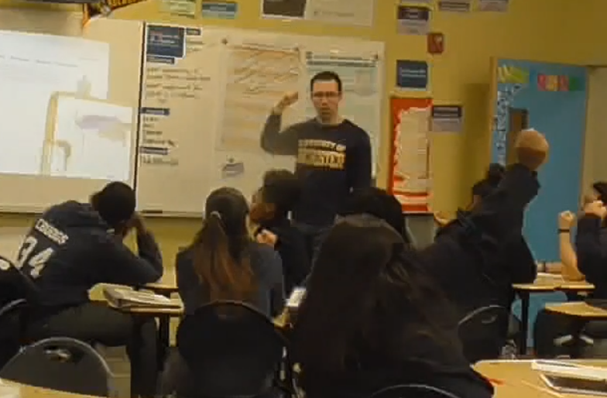
Portfolio Entry #2
Classroom Culture (CC)
Engaging Everybody
Wait Time
Cold Call
Everybody Writes
Turn and Talk
Call and Response
Notes:
UPDATE PORTFOLIO >> then update this slide

Slide 33
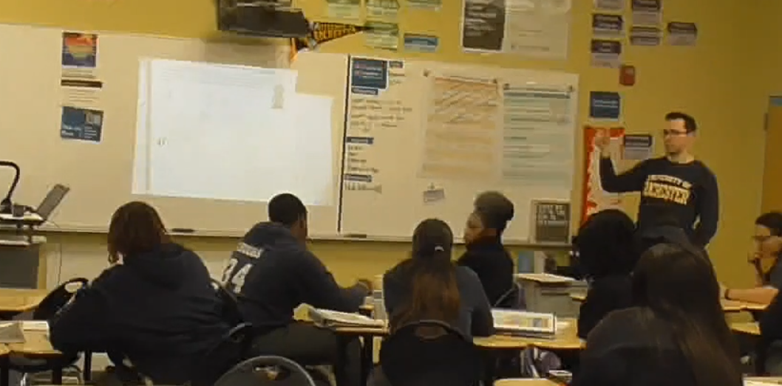
Portfolio Entry #3
Teaching Cycle (TC)
Implementing Rigorous Instruction
Ratio
Take a Stand
Stretch It
Chalk Talk
Notes:
UPDATE PORTFOLIO >> then update this slide

Slide 34
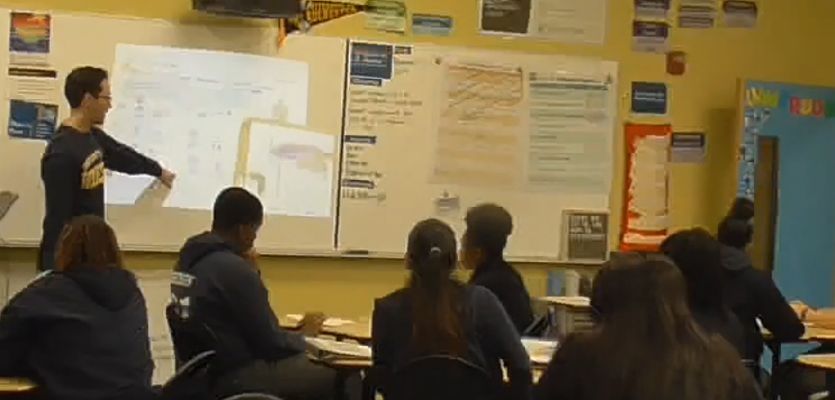
Portfolio Entry #4
Math Content
Generative Moves
Strengthen/Weaken Conclusion
Strengthen/Weaken Hypothesis
Generalize
Specialize
Consider the Converse
Notes:
UPDATE PORTFOLIO >> then update this slide

Slide 35

Key Insight #1
Developing strong flexible thinking requires supporting and pushing students to navigate situations with less structure and clarity.
MATH-304, MATH-305, Boaler
Three Act Tasks, Discourse, Rewriting Questions, Risky/Ambiguous Tasks
Notes:
NEED TO TYPE THIS OUT!
How will this insight change my actions in the future

Slide 36


Key Insight #2
When working with teachers and students, it is deeply important to listen and understand them so that you can best support and push them to be their absolute best.
SGA-301, SGA-303, Hammond, Duncan-Andrade.
Surveys, Conferences, Reflections, One on one interactions, public recognition
Notes:
NEED TO TYPE THIS OUT!
How will this insight change my actions in the future

Slide 37
Thank you!
My students
Professor Hill
Professor Farnum
Professor Greene
Dean V
Jeffrey Duncan-Andrade
Zaretta Hammond
Joe Boaler
WPHS Math Department
Syrena Burnam
Mike Taubman
Beth Verrilli
Allison Johnson
Alyse Amato
Ashling Coffey
Anushae Syed
Poorvi Goradia
Julia Addeo
Bill Koch
Danny Murray
Scott Kern
Andy Chen
Michael Mann
Chris Palermo
Denarius Frazier
Nick Stano
Blake Sukar
Alissa Fong
Melissa Scheve
Allison Post
Cassidy Rosenblum
Mike Woodward
Alex Sylvester
Phil Berkaw
Rachel Gainer
Amanda Page
John Allenbach
Trevor Baisden
Michael and Machael Sherry
Jennifer Brown
Dean and Ross Coapman
Scott and Susan Coapman
Jack and Hope Sherry
Jack and Connie Coapman
Justine Coapman

Slide 38
Questions

Slide 39
Research Question #2
What, if any, achievement differences exist between students that scored at or above mastery in character development vs. students that scored below mastery?
Notes:
Might need to adjust this investigation here

Slide 40
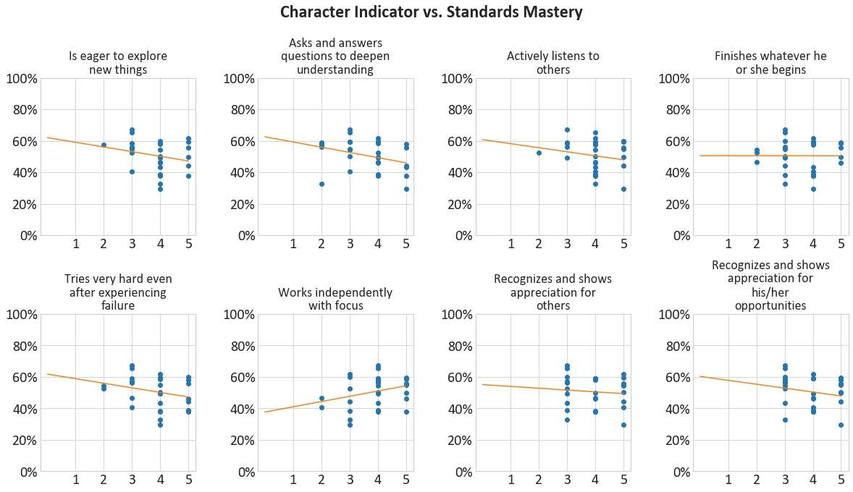
Research Question #2

Slide 41
Research Question #2
indicator | slope | intercept | r^2
Is eager to explore new things | -0.029655 | 0.620587 | 0.052376
Asks and answers questions to deepen understanding | -0.033073 | 0.625920 | 0.103636
Actively listens to others | -0.025687 | 0.607781 | 0.037672
Finishes whatever he or she begins | -0.000193 | 0.505732 | 0.000003
Tries very hard even after experiencing failure | -0.029129 | 0.617531 | 0.064941
Works independently with focus | 0.033331 | 0.376308 | 0.085028
Recognizes and shows appreciation for others | -0.011491 | 0.550602 | 0.008937
Recognizes and shows appreciation for his/her opportunities | -0.024846 | 0.602702 | 0.039347

Slide 42
Research Question #2
Statistically, there are no significant correlations between character strengths and standards mastery.
Working independently with focus interestingly was positively associated with mastery.
In the future, it will be important to measure these character traits with a common understanding of their meaning in an academic context.
Notes:
FORMALIZE THIS IN DATA NARRATIVE → then update this slide

